Slide 1
Adidas Service
Presented by: Jonathan, Michael, Gage, Courtney, Tanner, and Lucas
Notes:
Lucas
I would like to say good morning and thank you for you being here. Today we are going to present our regression model, the results it produced, and provide a financial impact estimate.

Slide 2
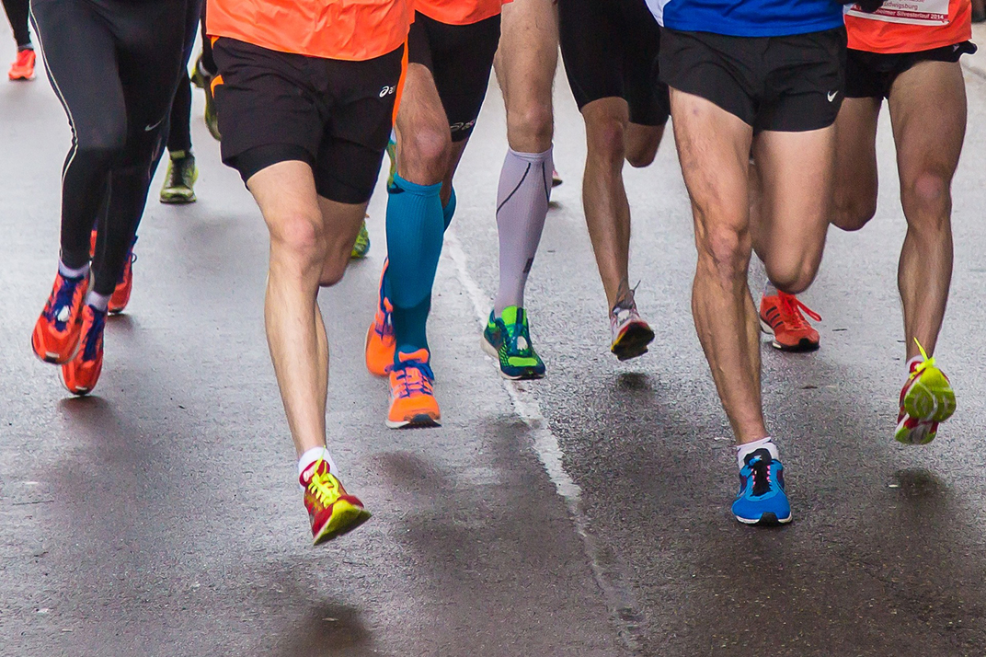
Industry Background and Competitors
The global athletic wear (footwear and apparel) industry was worth $304 billion in 2022
  Expected growth of 3.7% CAGR; expected to reach $365 billion in 2027
The global athletic footwear industry was valued at $127 billion in 2021
  Expected CAGR of 4.9% from 2022 to 2030
Industry growth driven by:
  Women’s footwear and apparel
  Athleisure popularity
  Health conscious consumers
Largest competitors are Nike, Puma, Under Armour, New Balance
Sources: Mobile Foresights, Grand View Research
Notes:
Lucas
Sources
Mobility Foresights
https://www.yahoo.com/now/global-sportswear-market-worth-365-134400496.html?guccounter=1&guce_referrer=aHR0cHM6Ly93d3cuZ29vZ2xlLmNvbS8&guce_referrer_sig=AQAAADB8QH1iLPqahIN-tY44rETVZlkg9hZTWWhpq40JcugXLA7MLH_ekI4r_0L5Sen73PLitjBOKTfTmPioOiOmVLn_WPf86oaUQKrMEW1h5rxzFiMwc2pDO_LmLbr8uBvsRuCfYD69ykXeqlurKAHcQNxBYr2ijjV6w_TeM-Q6CbG_
Grand View Research
https://www.grandviewresearch.com/industry-analysis/athletic-footwear-market
https://www.grandviewresearch.com/industry-analysis/activewear-market-report

Slide 3
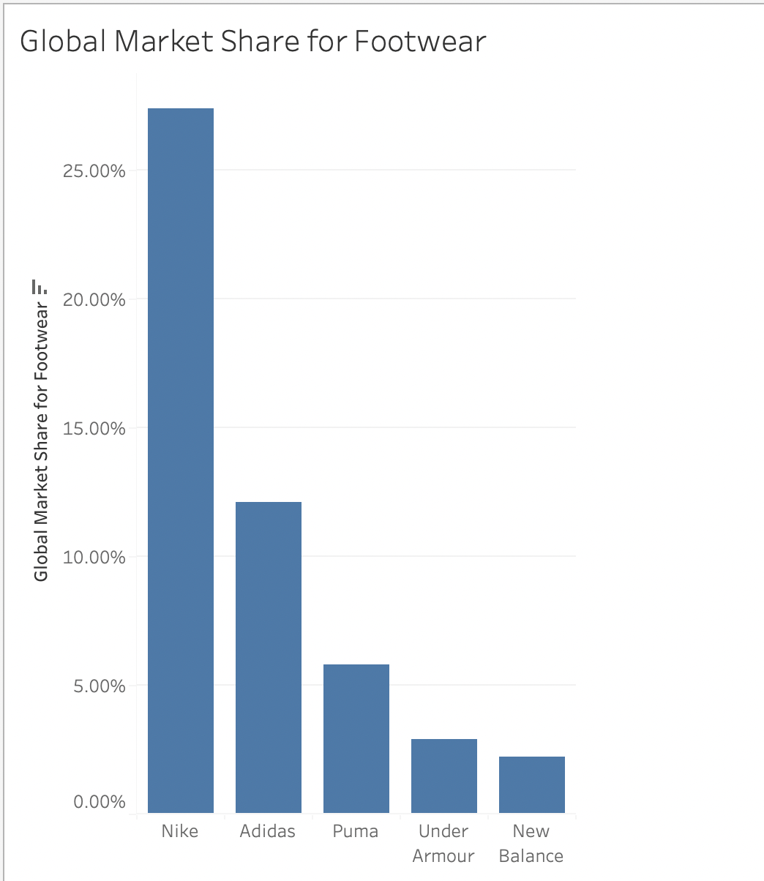
Adidas vs the Competition
Global Market Share
Footwear
Nike - 27.4%
Adidas - 12.1%
Puma - 5.8%
Under Armour - 2.9%
New Balance - 2.2%
Apparel & Footwear
Nike - 15.7 %
Adidas - 8.7 %
Puma - 2.3 %
Adidas competitive advantages:
Strong brand image, globally recognized
Global distribution networks, retail stores
Technology and innovation
Sponsorships/endorsements of high profile athletes and events
  Lionel Messi, FIFA World Cup, EURO
Strong sustainability initiatives
  Circular economy, end plastic waste
Notes:
Lucas
Source - ChatGPT

Slide 4

What is the winning strategy of the industry?
Brand recognition and loyalty is important
Consumers demand innovative products
  High performance and comfort
  Athletes looking for edge over competitors
Global distribution networks
Customer service
High profile athlete and event sponsorships for brand visibility
Notes:
Lucas

Slide 5
Million Dollar Question
Reassigned tickets are IT tickets that couldn’t be resolved by the originally assigned team and required escalation to resolve
On average, reassigned tickets take approx. 1 week longer to resolve than non-reassigned tickets
Ticket reassignment increases retail and warehouse downtime and contributes to IT labor expenses
Can Adidas reduce downtime and increase profits by identifying if a ticket will require reassignment at the time of submission?
Notes:
Lucas

Slide 6
Data Exploration and Visualization

Slide 7
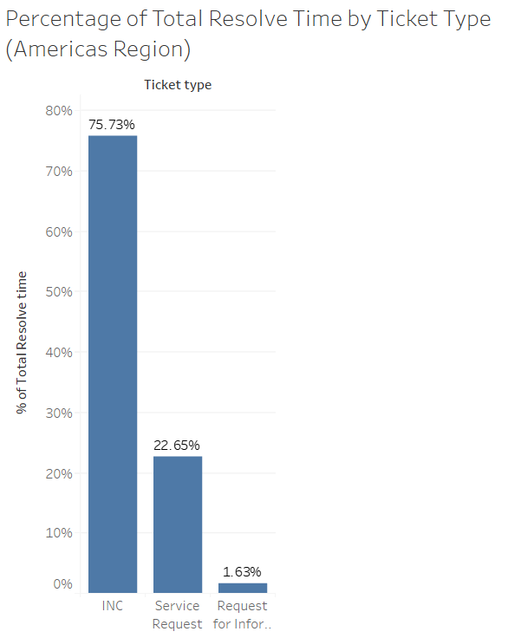
Incident (INC) Tickets
Incidents are unexpected events/downtime that need to be resolved quickly
The majority of time (75.73 %) is spent resolving incident tickets
Notes:
Gage

Slide 8
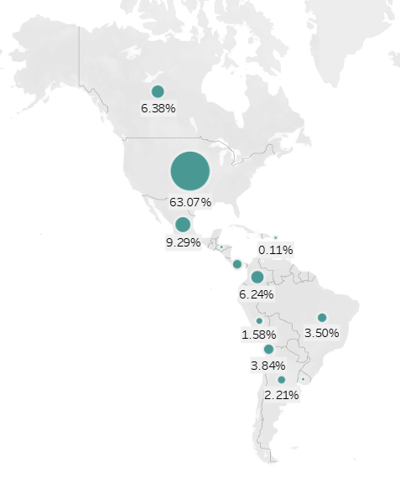
Geographical Distribution of Incident Tickets in the Americas
Notes:
Gage

Slide 9
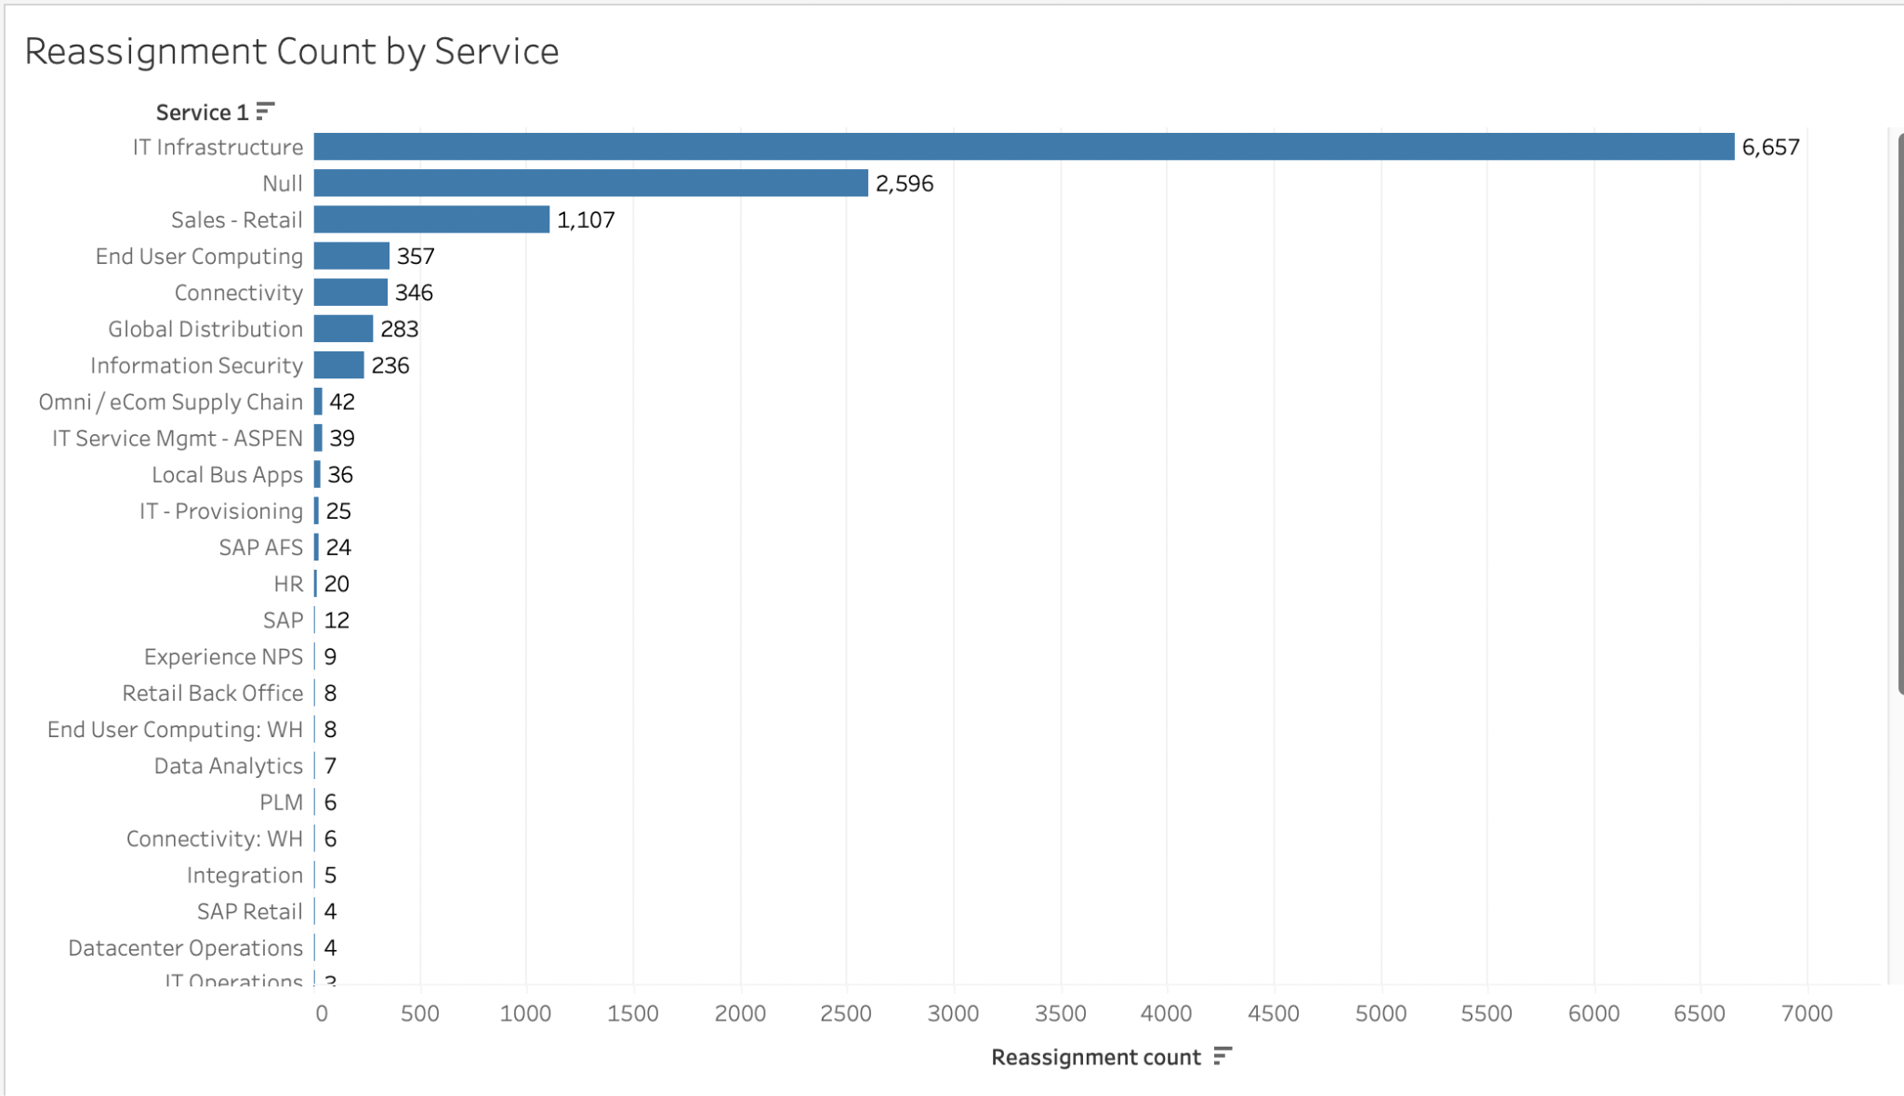
Reassigned Tickets
Reassigned tickets are tickets that cannot be resolved by the initial business group and need to escalated
Service_1 category IT infrastructure has the largest number of total reassignments
Notes:
Gage

Slide 10
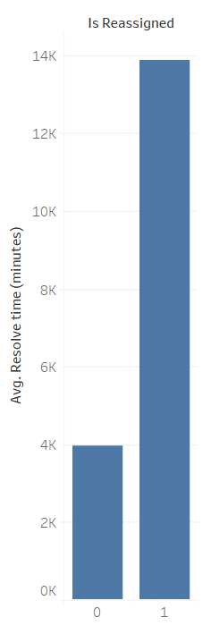
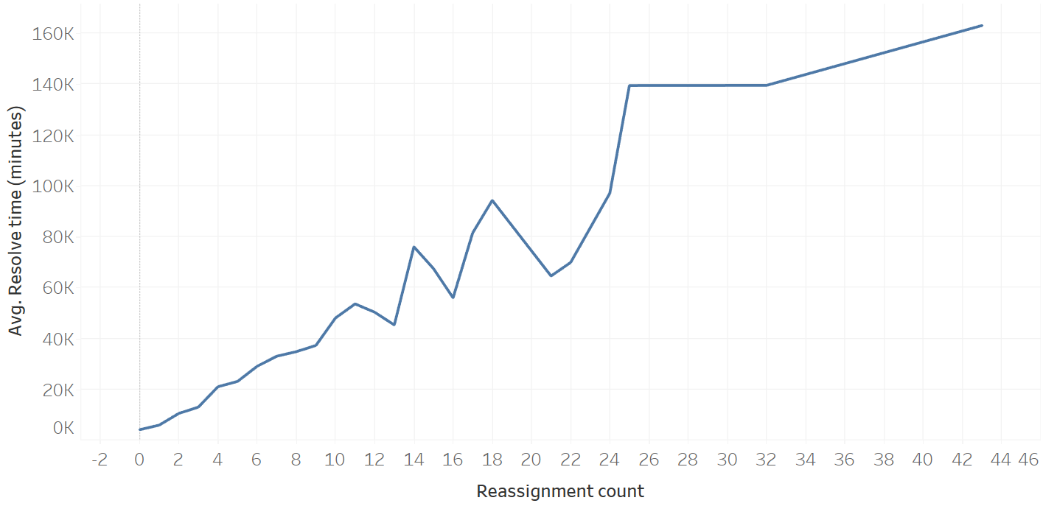
Reassigned Tickets
Average resolve time generally increases with reassignment count
Tickets that were reassigned at least once take on average ~10,000 additional minutes (~1 week) to resolve
To increase efficiency: predict if tickets will be reassigned at the time of submission
Notes:
Gage

Slide 11
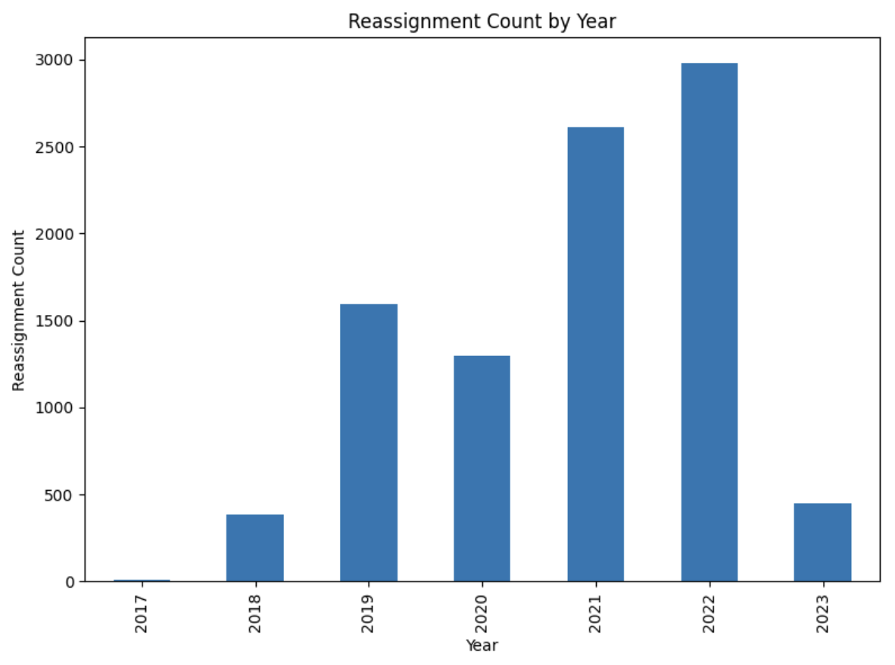
Reassigned Tickets
The number of reassigned tickets has been increasing in recent years
Notes:
Gage

Slide 12
Model Development and Validation

Slide 13

Chosen Variables
Dependent:
  Reassignment Count
Independent:
  Impact, Priority, Urgency
  SLA Type, Service, Service_1, Subservice, Ticket Type, Category
  Country, Adidas Market
Impact, Priority, and Urgency variables were simplified into text categories
Notes:
Michael
Before we get into the specifics on how the model worked, it is important to lay out the variables we used for it first to provide context for what is essentially the bedrock of our logistic regression. Our dependent variable was the reassignment count, which is fundamentally what we are trying to predict with our model. After going through multiple variations we settled on a set of 9 independent variables that we believed would provide useful results.
One chunk of those variables included Impact, Priority, and Urgency, which represented how serious the ticket was thought to be from the perspective of whomever made the ticket. We believed that it was reasonable to assume that the reported seriousness of a given problem would be a factor that would influence the likelihood of a ticket being reassigned. As a small sidenote, we did end up having to edit these three variables to reduce redundancy by removing their number category and just keeping their text description for when we ran them through the regression.
The second portion of independent variables we chose, which included SLA Type, Service, Subverice, Category, and Ticket Type provided information on what system was being affected by the issue detailed in the ticket. By feeding the model variables like these it could potentially pick up on patterns where certain combinations of system issues hint at whether it would be later reassigned or not.
Our last two independent variables which we chose were country and market. These variables are just pointing out the region of origin for each ticket. Given how other issues at Adidas are known to have had regional components to them, such as the power outage issue in the Americas that was brought up a while back, it did not seem like a bad idea to include some of those variables in the model to see if it later helped boost predictive accuracy.

Slide 14

Has Reassignments Been Increasing With Time?

Slide 15
The Model
Predict the outcome of a categorical variable
whether a ticket will be reassigned
‘Reassignment Count’ was converted to a binary variable:
  0 = ticket not reassigned
  1 = ticket reassigned at least once
The categorical variables were converted to numerical values by creating dummy variables
  Example: Urgency_text was converted to dummy variables: urgency_text_high, urgency_text_low, urgency_text_ medium; with values of 0 or 1 for each
Reassigned tickets are relatively rare in the data set: oversampling was used in the training set to achieve an equal number of reassigned and non-reassigned tickets
Two models were generated: logistic regression and gradient boosting
Notes:
Michael

Slide 16
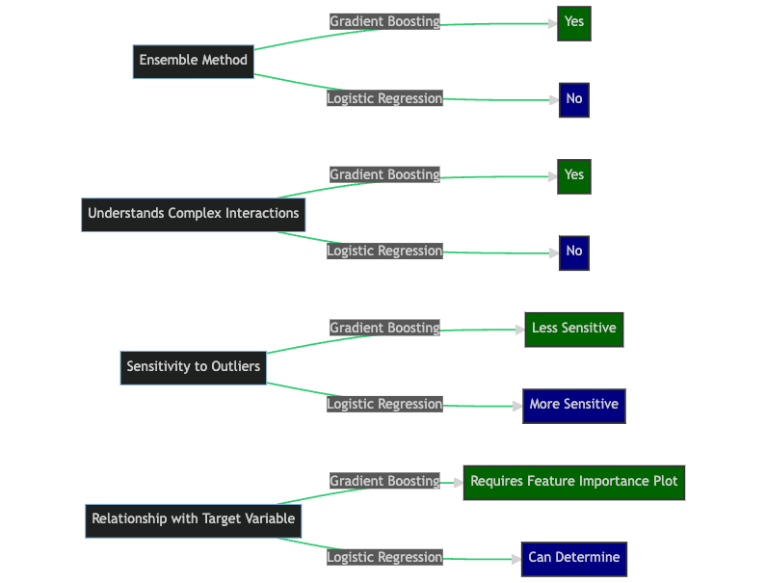
The Gradient Boosting Model vs logistic regression
Notes:
Michael

Slide 17
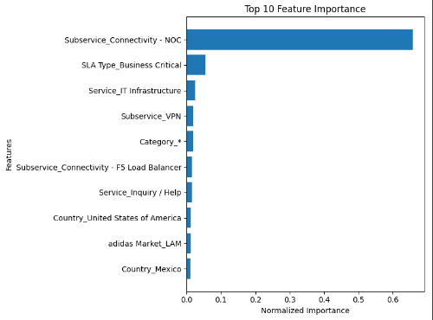
Our Model and Insights
Notes:
Michael
Here we can see the Features used to produce our model. the feature importance plot shows "SLA Type_Business Critical-" at the top with the highest normalized importance, it means that the presence or absence of the "Business Critical" category within the "SLA Type" attribute has the highest importance in our model in predicting the target variable (whether an incident is reassigned or not). In summary, knowing the feature importance, particularly the importance of "SLA Type_Business Critical-," provides valuable insights into the factors driving incident reassignments and can inform decision-making, process optimization, and business targeted actions to improve incident management.

Slide 18
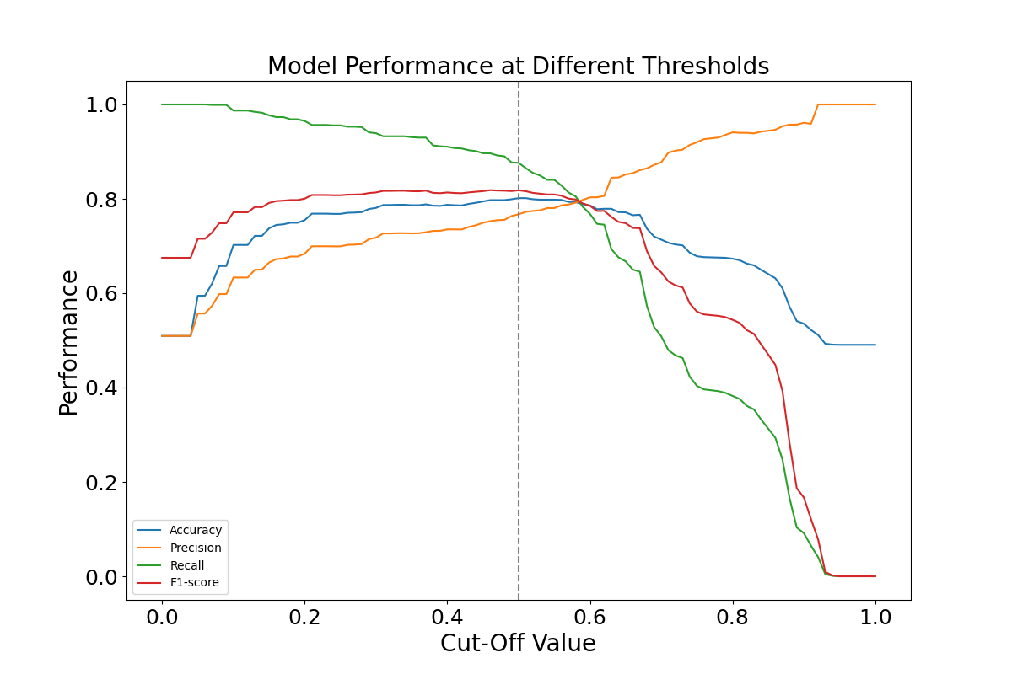
Gradient Model Performance - Oversampled Validation Set
Accuracy: 80.1 %
Recall: 87.1 %
Precision: 76.9 %
F1-Score: 81.7 %
Confusion Matrix:
Predicted
 | Negative | Positive
Negative | 760 (TN) | 283 (FP)
Positive | 140 (FN) | 943 (TP)
Actual
Notes:
Courtney

Slide 19
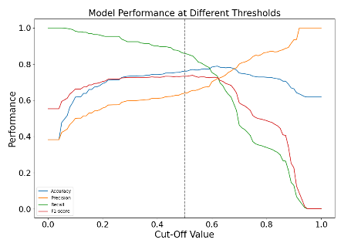
Gradient Model Performance - Non-Oversampled Validation Set
Accuracy: 76.1 %
Recall: 85.8 %
Precision: 63.9 %
F1-Score: 73.3 %
Predicted
 | Negative | Positive
Negative | 744 (TN) | 318 (FP)
Positive | 92 (FN) | 565 (TP)
Actual
Notes:
Courtney

Slide 20
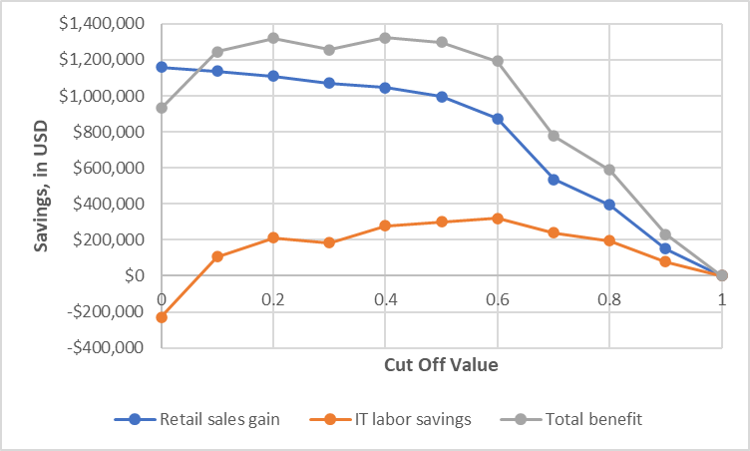
Estimated Financial Impact
Ideal cut off value is 0.4
Labor cost savings:
  Total Per Year: approximately $277,126
  Assumptions:
    ~$1,000 saved when reassigned ticket is correctly predicted
    ~$833 in costs when the model incorrectly predicts reassigned ticket
Retail store sales savings:
  Total per year: approximately $1,044,714
  Assumptions:
    The avg Adidas retail store makes $10,000 in sales per day (ChatGPT)
    “Priority = Critical” retail location tickets result in store downtime
    10.32% of submitted tickets are critical and retail location
Notes:
Courtney
We know for a fact that when a ticket is reassigned it almost always costs more money to resolve. Beyond that, you have to consider that every minute a ticket goes unresolved, it is harming an Adidas operations ability to bring in revenue. When trying to determine how much our model could save Adidas in labor, we had to make some assumptions to get our estimates as we lack exact figures. We based this estimate on the idea that every time the model correctly predicts that a ticket will be reassigned it saves on average about $1,000 as a lower level IT person does not spend their time on it to begin with. That being said, when the model wrongly predicts a reassignment, it could cost Adidas as much as $833. When you take the costs and savings together though, you end up with that top line figure of $476,000 in savings per year.
Found from chat GPT for adidas retail store sales:
For an average Adidas retail store, the estimated daily sales can vary based on the factors mentioned earlier. However, to provide you with a rough estimate, we can consider a range of $5,000 to $15,000 in sales per day for an average Adidas store.
It's important to note that this estimate is a general approximation and can still be influenced by various factors. Factors such as store location, size, customer demographics, product assortment, marketing efforts, and seasonal trends can impact the actual daily sales.
Calculation:
For this calculate, I took the middle range from ChatGPT: assume avg sales of $10,000 per day in sales for an adidas retail store
Estimate downtime from incidents: I used the Critical (Priority 1) incidents for the retail category only (“RTL Retail User” = TRUE). I used the critical incidents because these are likely the ones causing the most disruptions at the stores (assume critical incidents cause the most lost sales)
Avg resolve time for non-reassigned tickets = 1109 minutes (18.48 hours)
Avg resolve time for reassigned tickets = 3574 minutes (59.57 hours)
Extra resolve time for reassigned tickets = 2465 minutes = 41 hours = 1.71 days
Retail cost of 1.71 days of downtime = 1.71 * $10,000 = $17,100 (model would ave $17,100 for retail location - for priority 1 (critical) incidents at retail locations)
565 true positives identified by the model = 565 * $17,100 = $12,996,000 (but, this would be the savings in sales if all tickets were critical and retail; but we know this isn’t the case. We need to determine the percentage of tickets that are critical and retail)
What proportion of the data set is critical priority retail location tickets?
Total # of tickets in data set (INC only, Americas) = 8595
Number of tickets in data set with ‘Priority’ = ‘1 - Critical’ and ‘RTL Retail User’ = TRUE is 887
The percentage of critical retail tickets is 10.32 %
For retail sales savings:
Total savings in 1 year = $9,661,500 * 0.1032 = 997,067
From ChatGPT for cost of an IT worker/labor:
The average hourly cost of an IT worker who resolves network operations tickets can vary depending on factors such as their level of experience, geographic location, specific job responsibilities, and the organization's industry. Additionally, costs can differ between full-time employees and contractors.
To provide you with a rough estimate, let's consider the average hourly rates for IT professionals in the United States. Please note that these figures are general and may not reflect the specific circumstances of your situation.
Entry-Level IT Technician: An entry-level IT technician typically earns an average hourly rate between $15 and $25. -$2000 Average cost Non-Reassigned $1,000 for Reassigned
Mid-Level IT Engineer: A mid-level IT engineer with a few years of experience might have an average hourly rate ranging from $25 to $45. -$10,000 Average cost $833 if Wrong
Senior-Level Network Engineer: A senior-level network engineer or an IT specialist with extensive experience and advanced certifications can command an average hourly rate of $50 to $100 or more.

Slide 21

Proposed Solution and Its’ Strategic Value
Integrate a predictive model into the current ticketing system
Allows for less reassignments, saving time and money
Strategic value includes: Extra time, further reduced costs, employee efficiency, and morale

Slide 22

How will the business processes be changed?
Current process adjustment would be minimal
Current system would require adaptation
Would require coding work

Slide 23
Does Adidas have the Skills?
Skills Needed:
Programming
Analytics
Statistics
Machine Learning
Internal Knowledge of Databases and Systems
Teamwork and Communication Skills
✅✅✅✅✅✅
Notes:
-Tanner
Anytime you are talking about introducing a new or altered system into a companies routine, you have to take a step back and consider if they have the right skills to manage the job.
Fortunately, Adidas is a large company that has tens of thousands of employees with very diverse and comprehensive skill sets. This includes data scientists, software developers,
solution architects, business analysts and much much more. Suffice it to say, Adidas certainly has people with the sort of programming, statistics, and machine learning skills or
knowledge that they would need to implement the model we developed. However, the more important question would be whether they have time and will to see such a thing done,
which brings us to some of the challenges that our model could face.

Slide 24
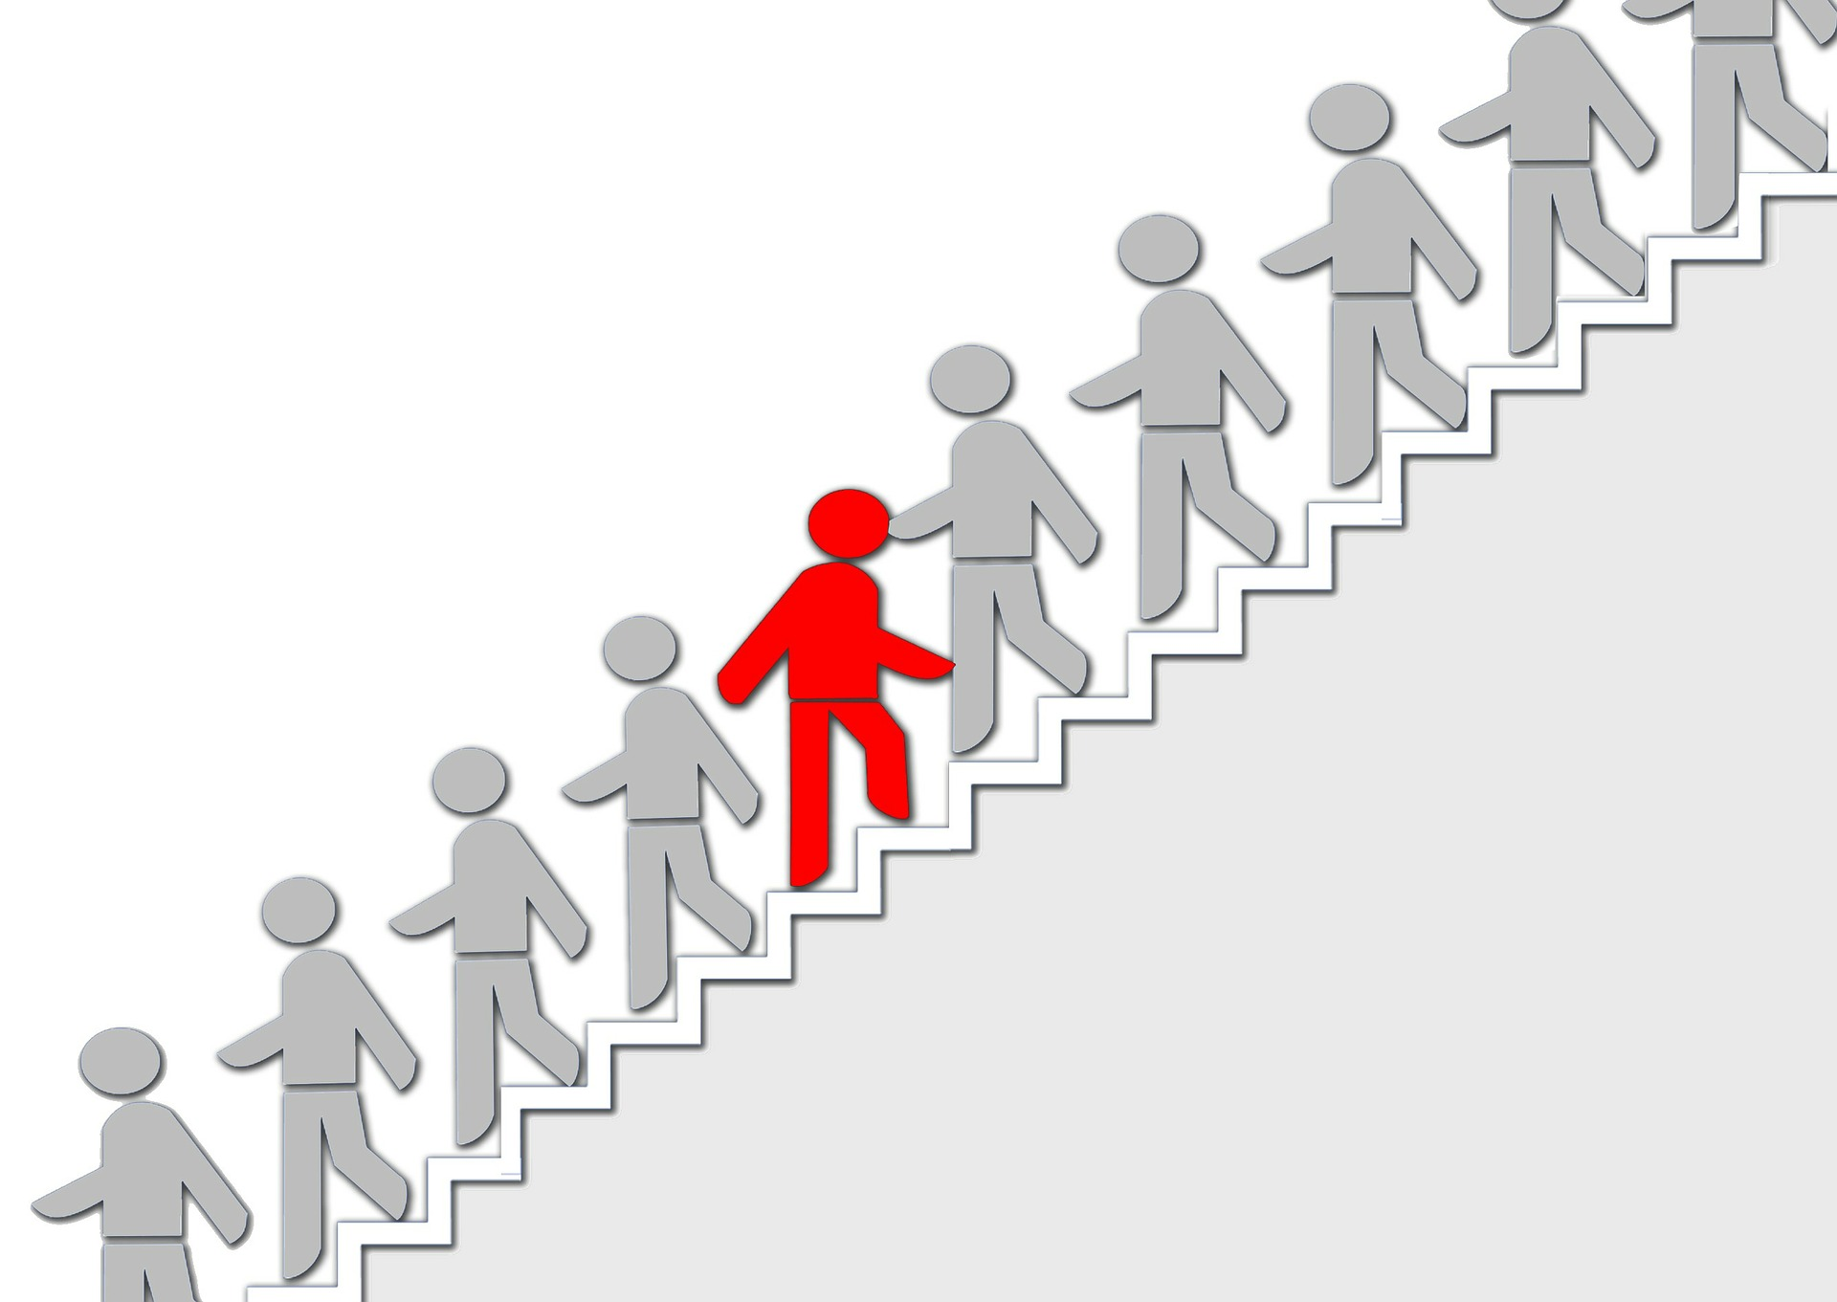
Resistance to the Model
Time Constraints
  Building and introducing a new model takes time - a precious resource
Job Threatened
  Individuals may see the introduction of a new process as competition
Lack of Trust
  If people don’t believe a new process works, they may not embrace it
Notes:
-Tanner
While we firmly believe that a model like ours could save Adidas a lot of money, it would be naive to expect there to be no resistance to its implementation. The staff at Adidas are
undoubtedly busy working on their own projects, and finding the time to learn and introduce a new system to handle tickets will not necessarily be easy. Due to this, it is important that
there would be time made available for staff to handle the new process without harming their ability to meet their other responsibilities.
There is also the risk that some employees who are more familiar with the current ticket assignment system will view this new method as being a threat to their authority, space, or
even job. To combat this fear, it is critical that the model be presented as an aide to help them and not a tool for replacing or minimizing their roles at the company.
Beyond that, it is critical that employees at Adidas buy into the concept of assigning tickets based off of a model to begin with. People do not innately trust whatever new thing you
throw at them, especially things that they do not understand. To push this process forward without clearly explaining its purpose, uses, limitations, and effectiveness to them invites
suspicion and resistance to the idea. To generate trust from Adidas employees, one must make sure that you clearly explain what the reassignment model is going to do and how it
relates to them. If everyone understands the model right from the beginning, you will undoubtedly discover that people are much more willing to give the system a chance rather than
simply dismiss it out of hand.

Slide 25

Chat GPT’s Role
Uses:
  Idea Generation
  Help with code issues
  Definitions of different terms
  Information about the footwear/sportswear industry
  Company profile knowledge
  Information about predictive models and how to utilize for information gain
  General Inquiries
Notes:
-Tanner
Throughout our whole project we have been able to use Chat GPT to great effect. There were many instances where it was able to point us in the right direction when it came to
generating ideas or debugging our code. In fact, it was often easier and faster to ask it many of our more general inquiries when it came to gathering information about the
sportswear industry as a whole or even Adidas specifically. However we quickly discovered that Chat GPT has its limitations. It would sometimes provide different information
depending on who asked the question, and we always had to edit whatever coding ideas it gave us to suit our specific needs. Overall, we found that Chat GPT was a great time
saver, though it is still a very long ways away from being able to build entire models on your behalf.

Slide 26
Thank You
Questions?
Notes:
-Tanner
With that final note we conclude our presentation, and we thank you for listening.

Slide 27
Gradient Boosting Code
We import the required libraries and read in the csv data
We convert the reassignment variable into a binary variable
We pre-process the data, splitting columns we need to split
We drop non-relevant columns
We define the features (x variables) and target variable (Reassignment attribute)
We apply oversampling to the data
We encode categorical features into binary format using ONeHotCoder
Split data into training and test sets
Build and train gradient boosting model
Make predictions and evaluate model performance
Generate confusion matrix
Notes:
(Reference Slide)

